Slide 1
Emotion based Information Retrieval
Member: Weiyi He, Kaiyang Lv, Linzi Zhang

Slide 2

Outline
Introduction
System Design
Implementation
Future Plan

Slide 3
Introduction
Diverse News
Hard to find specific information with emotion
Improve IR system’s functionality
Add Emotion tags
Notes:
In our current life, there are all kinds of news around the world. And the enormous quantities of news become a huge challenge for us the to get the specific information from diverse articles and websites. As we know, the common way is to use only keywords or key for searching.
And we need to figure out a novel method to get useful information such as news with emotion tags. So, we are interested in improving the functionality by add the emotion based. Which can lead to a more specific and effective reults.

Slide 4

System Design
0) Calculation the documents’ emotion value
Server
1)Query topic
2) Initial search result
User
Search results
3) Apply the emotion value to the query and result
4)Show search results with emotion tendency (top 10)
Notes:
In our project, the initial search result will not be shown at client surface.

Slide 5
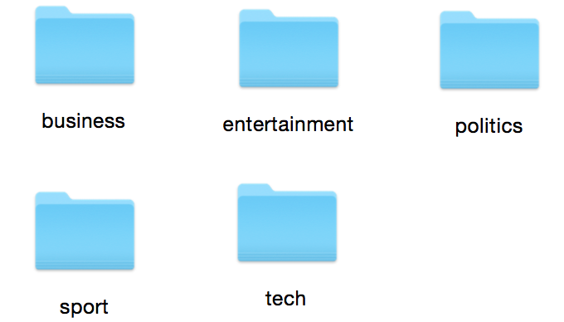
Data Collection
We use the BBC news which is short and clear acquired from the websites.
INCLUDING: Sport, Business, Politics, Entertainment and Technology.
2225 news in total

Slide 6
Serving
For instance,
News websites like BBC
Blogs inner-search function
Search Engine

Slide 7
Use scenario
WHEN
User searching information
WHY
Their specific need of information with emotion tendency

Slide 8
Implementation
Major Component
Preprocessor
Language Model Retrieval Engine
Emotion Calculation
GUI Interface

Slide 9
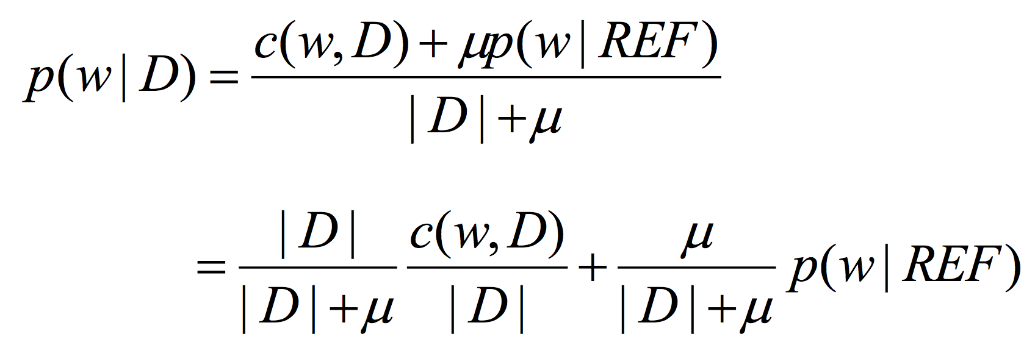
Implementation
Preprocessor
Tokenization
Normalization
Remove Stop word
Emotion value Computation
Language Model Retrieval Engine
Dirichlet Prior Smoothing

Slide 10

Implementation
Emotion Calculation
We have both positive and negative word package. (positive= 1, negative=-1)
Calculate the emotion value of each document.
Each documents’ emotion value =
$\sum_{i=1}^{n}{\text{(}\text{Emotion}\text{ * }\frac{1}{x})}$ (n: total number of words in the document, x: the position of the words in the document)

Slide 11
Implementation
Emotion Calculation
1. We use variable ”Emotion” to identify the emotion tag users choose.
Positive = 1, Negative = -1
2. Return top 20 relevance documents.
3. Multiply the relevance value and the emotion tag value.
4. Rank the list. Return the top 5 documents
Positive choice: decrease list
Negative choice: increase list

Slide 12
Implementation
Input
Keyword, Emotion tag
Output
A list of relative results ranked with emotion value (Only display the top 5 News from the list)

Slide 13
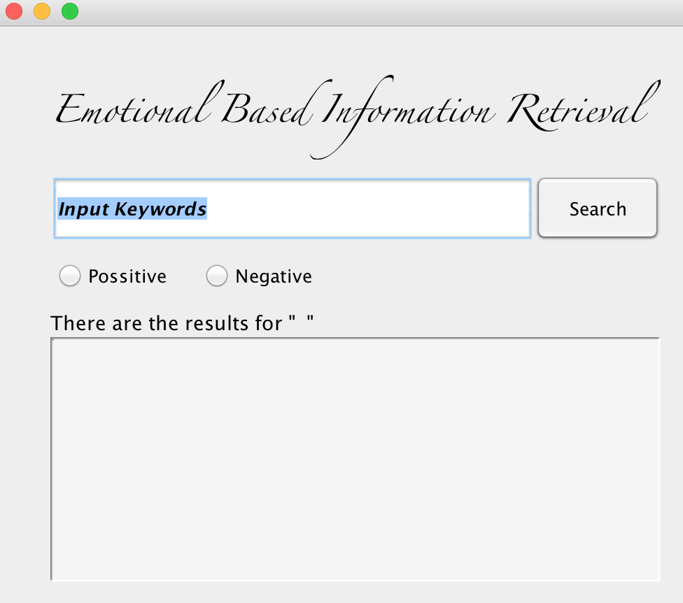
Implementation
GUI Interface
Input the keyword
Choose the emotion radio button
Click on the search button
The final results with keyword and will list as its specific emotion value decrease

Slide 14
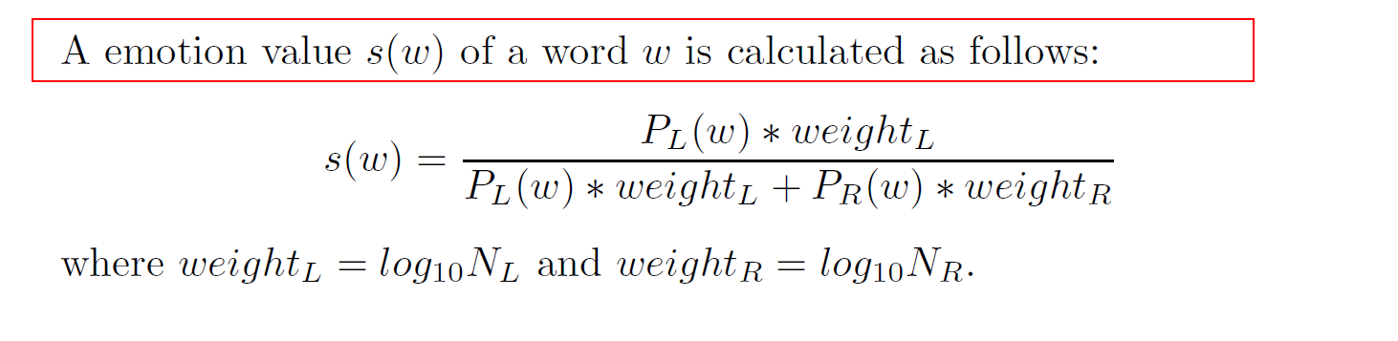
Lesson Learned
What we learned:
We use the preprocessor learned from the class and homework and apply the language model as the core of our system.
From the paper, Personalized Web Search Using Emotional Features BT, we are acknowledged that the emotion design in the IR are effective for searching. And the Formula of the evaluation calculation are helpful for us to modify and develop our own calculation of emotion.

Slide 15
Future Plan
We would like to enlarge the dataset of the news to get a more efficient evaluation to see if the calculation formula is perfect for our system.
Add Wildcard Matching function to satisfy people without precise target keyword for searching
Give some more detailed emotion value, such as happy, angry, sad…

Slide 16
References
Norman, D. A. (2004). Emotional Design: Why we love (or hate) everyday things. New York: Basic Books.
Norman, D. A. (2002). Emotion and design: Attractive things work better. Interactions Magazine, ix (4), 36-42. Retrieved at: http://www.jnd.org/dn.mss/emotion_design.html.
Zhang, J., Minami, K., Kawai, Y., Shiraishi, Y., & Kumamoto, T. (2013). Personalized Web Search Using Emotional Features BT - Availability, Reliability, and Security in Information Systems and HCI: IFIP WG 8.4, 8.9, TC 5 International Cross-Domain Conference, CD-ARES 2013, Regensburg, Germany, September 2-6, 2013. Proceedings. In A. Cuzzocrea, C. Kittl, D. E. Simos, E. Weippl, & L. Xu (Eds.), (pp. 69–83). Berlin, Heidelberg: Springer Berlin Heidelberg. http://doi.org/10.1007/978-3-642-40511-2_6

Slide 17
Demo
Demo Time

Slide 18
Thanks for Watching!
Questions?

